Slide 1
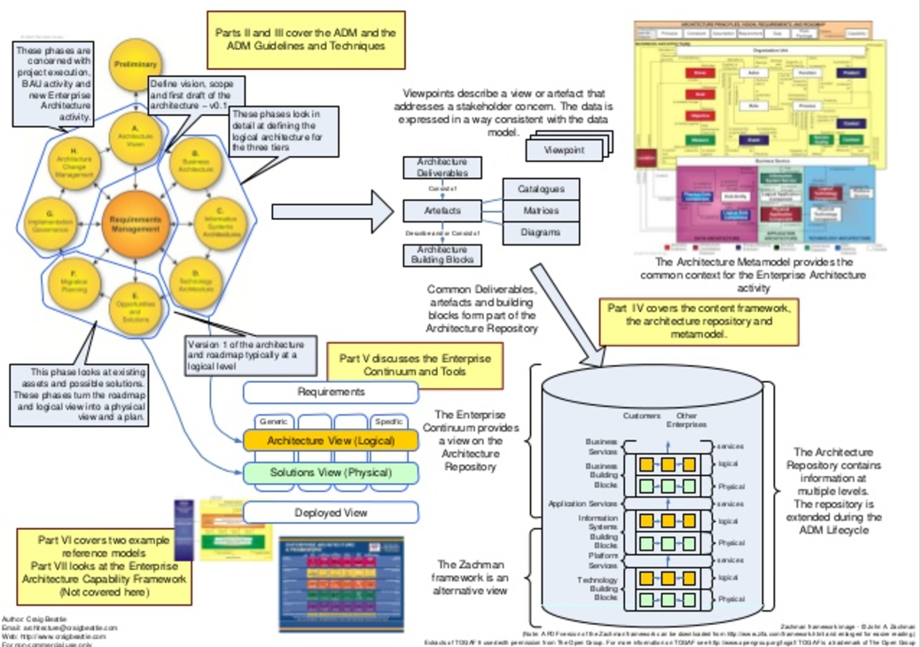

Slide 2

1. Part VI covers two example reference models Part VII looks at the Enterprise Architecture Capability Framework (Not covered here) Part IV covers the content framework, the architecture repository and metamodel. Part V discusses the Enterprise Continuum and Tools Requirements Deployed View SpecificGeneric Architecture View (Logical) Solutions View (Physical) Customers Other Enterprises Business Services Application Services Platform Services Business Building Blocks Information Systems Building Blocks Technology Building Blocks logical Physical logical Physical logical Physical services services services The Architecture Repository contains information at multiple levels. The repository is extended during the ADM Lifecycle The Enterprise Continuum provides a view on the Architecture Repository Architecture Deliverables Artefacts Consist of Architecture Building Blocks Describe and/or Consist of Catalogues Matrices Diagrams The Architecture Metamodel provides the common context for the Enterprise Architecture activityCommon Deliverables, artefacts and building blocks form part of the Architecture Repository This phase looks at existing assets and possible solutions. These phases turn the roadmap and logical view into a physical view and a plan. The Zachman framework is an alternative view Version 1 of the architecture and roadmap typically at a logical level Parts II and III cover the ADM and the ADM Guidelines and Techniques Define vision, scope and first draft of the architecture – v0.1 These phases are concerned with project execution, BAU activity and new Enterprise Architecture activity. These phases look in detail at defining the logical architecture for the three tiers Viewpoints describe a view or artefact that addresses a stakeholder concern. The data is expressed in a way consistent with the data model. ViewpointViewpointViewpoint Zachman framework image - © John A. Zachman (Note: A PDF version of the Zachman framework can be downloaded from http://www.zifa.com/framework.html and enlarged for easier reading.) Extracts of TOGAF 9 used with permission from The Open Group. For more information on TOGAF see http://www.opengroup.org/togaf/ TOGAF is a trademark of The Open Group Author: Craig Beattie Email: architecture@craigbeattie.com Web: http://www.craigbeattie.com For non-commercial use only

